Slide 1
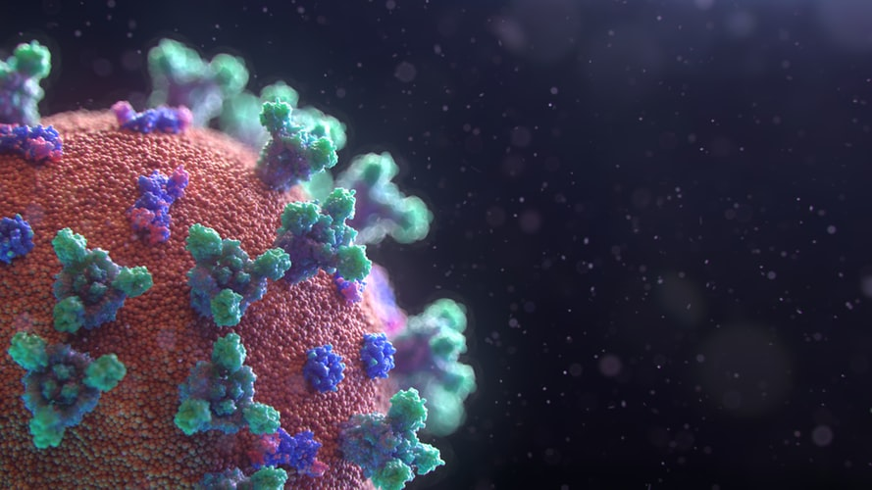

Masters Thesis
AI-Powered COVID-19 Research Cockpit
Feature & Concept Prototyping
Jon-Paul Boyd
18th October 2020

Slide 2
Overview Feature & Concept Prototyping
Assessing viability of a cockpit empowering COVID-19 medical research using pillars of A.I. Essential features including information extraction, literature clustering, search & summarization are prototyped in Jupyter notebooks, with results provided.

Slide 3
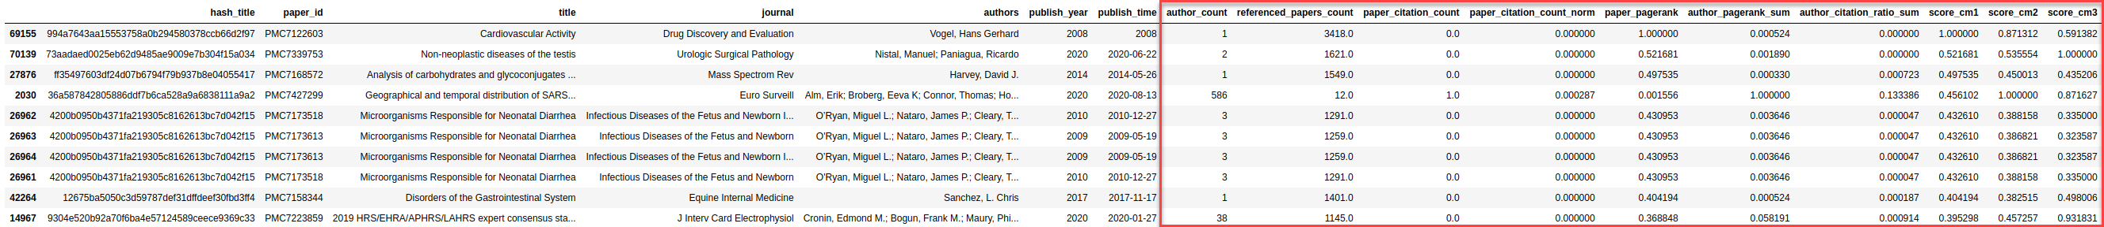
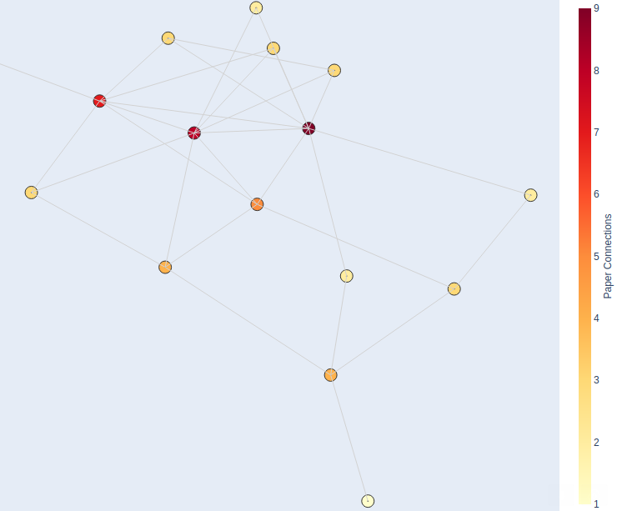
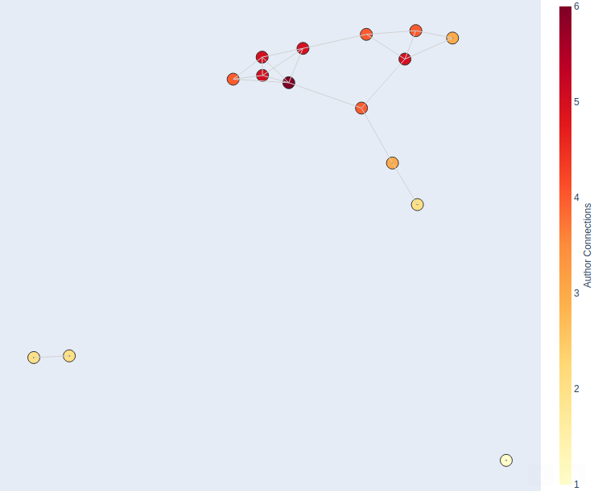
Paper Ranking Metrics With Author Influence & Paper Citations
Several custom metrics enable paper importance weighting, formulated using paper author & citation counts/ratios, the PageRank algorithm applied to assembled network graphs of authors & papers. Such metrics can weight paper scores in search.
Distribution of several ranking approaches across corpus, can be used to fine-tune metrics
Subset of paper & author network, deeper colours indicate greater influence
Papers
Authors

Slide 4
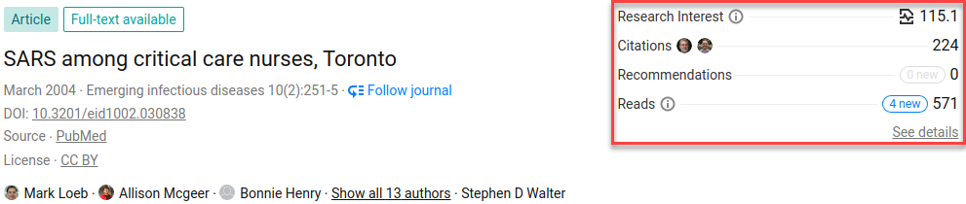
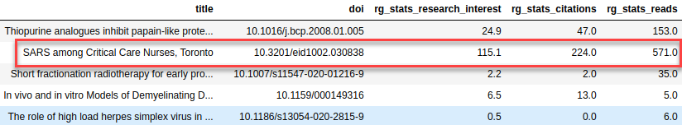
Enriching CORD-19 Dataset ResearchGate Web Scraping
Sourcing useful additional article data from 3rd-party sources such as ResearchGate, which indicates each paper’s research interest, citation count, recommendations & number of reads. Can be integrated into scoring metrics and filtering.
Web page data scraped and added to article metadata.

Slide 5
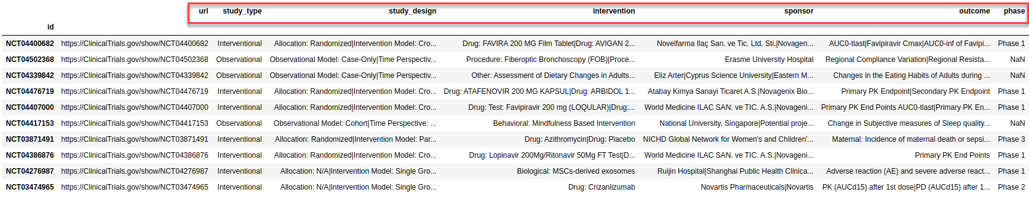
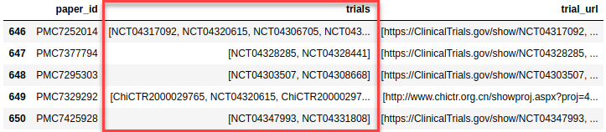
Enriching CORD-19 Dataset Adding Clinical Trial Information
Sourcing useful clinical trial data including study type & design, trial phase, intervention, sponsor and outcome.
Multiple trials per paper is managed.

Slide 6
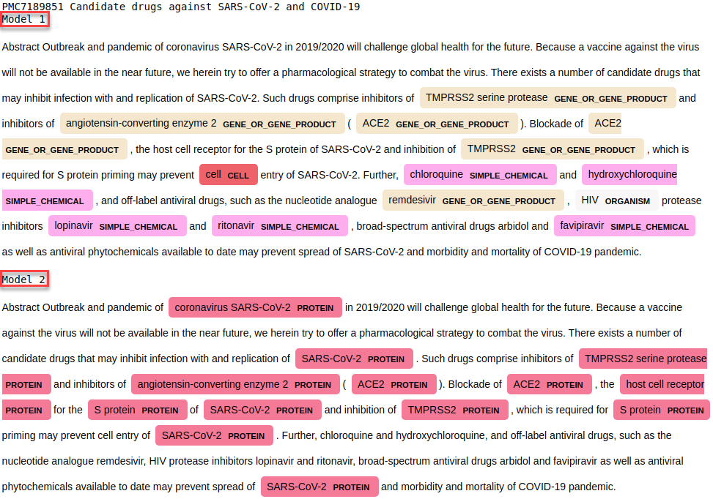
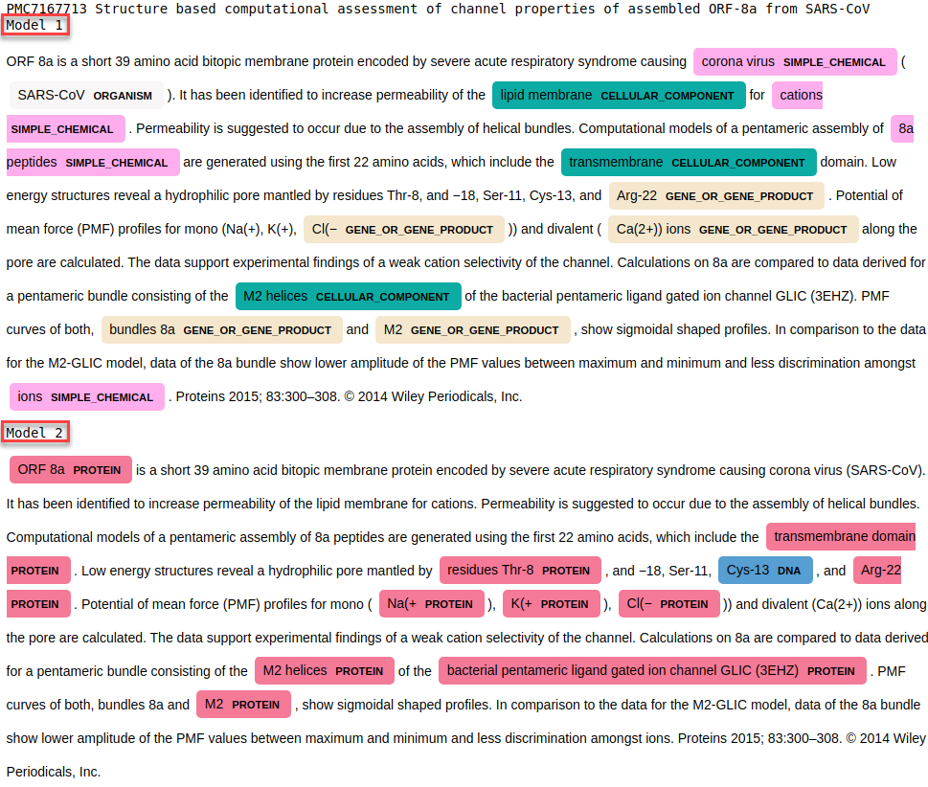
Named Entity Recognition For Entity Classification
Used to classify text entities into categories. Useful in providing a summary overview of the article, clustering documents by entities, used as selectable facets in document filtering etc.
The examples below show the same article abstract processed through 2 different NER models.

Slide 7
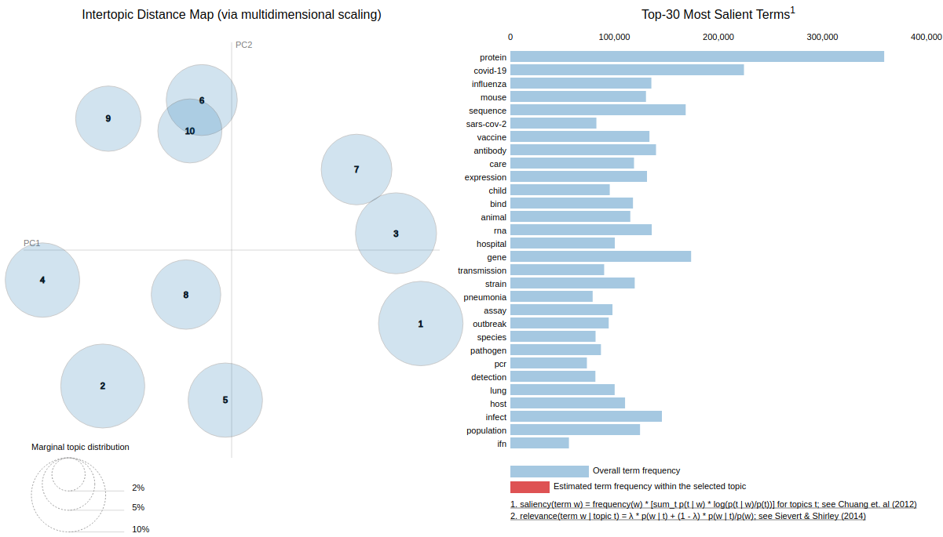
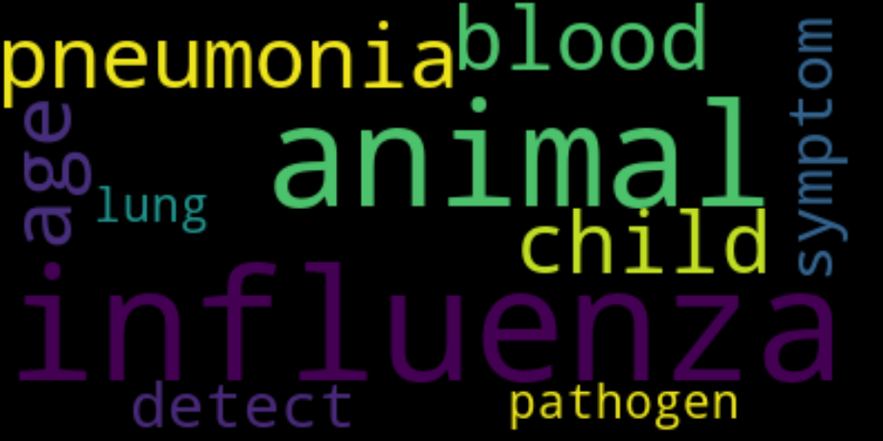
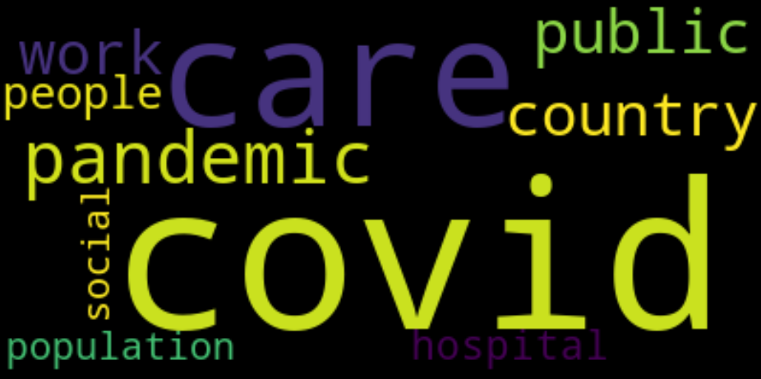
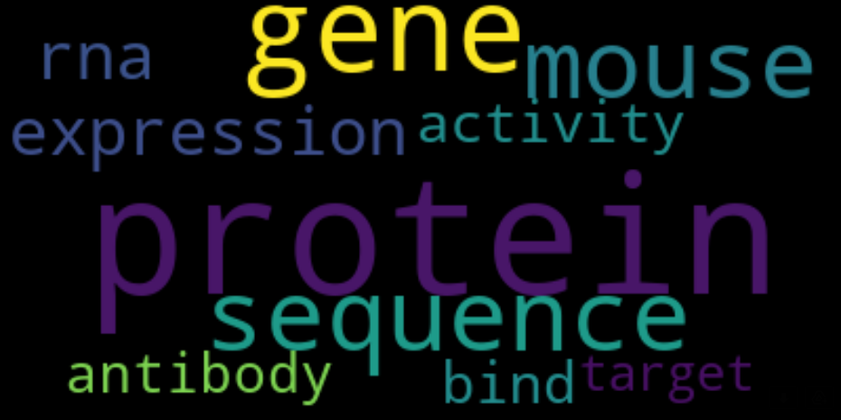
Improved Topic Modelling For Document Categorisation & Clustering
Refined over previous feature presentation. For purposes of demo, example illustrates a 2-layer topic modelling design over 50K Cord-19 article abstracts. First, 3 main topic themes are generated, followed by 10 sub-topic themes. Each document is categorised with both a main & sub-theme topic. This provides a hierarchical topic model that can be drilled down. In reality, sub-themes could comprise hundreds of topics to facilitate exploration by topic filter & determining related articles during search result compilation. The inter-topic distance map, reducing topics to 2 dimensions using PCA, shows good cluster separation (except 6 & 10, ), one tool to help determine best number of topics in each layer.
Main Topic 1 Main Topic 2 Main Topic 3
Sub Topic 7
7803 docs
care
covid-19 hospital pandemic medical
staff
contact healthcare participant work
Sub Topic 4
7047 docs
covid-19
sars-cov-2 mortality symptom
trial
sars
ace2
outcome
lung
therapy
Sub Topic 2
6762 docs
public
country
social
people
global
development
work
policy
government community
Sub Topic 9
5156 docs
protein sequence
rna
bind
gene
acid
genome structure
site
domain
Sub Topic 8
4659 docs
expression activity
protein immune mouse
gene
receptor
Ifn
pathway induce
Sub Topic 6
3978 docs
solution concentration
data
point
air
particle structure average
node performance
Sub Topic 1
3794 docs
antibody vaccine
mouse
animal
strain
serum
infect
antigen
culture
assay
Sub Topic 3
3781 docs
population transmission species outbreak
infect
host
animal epidemic sequence
bat
Sub Topic 5
3559 docs
influenza child detection
pcr
detect pneumonia pathogen assay
rsv
bacterial
Sub Topic 10
3059 docs
blood
lung
therapy
tissue
lesion
common
pulmonary
diagnosis
normal
chronic

Slide 8
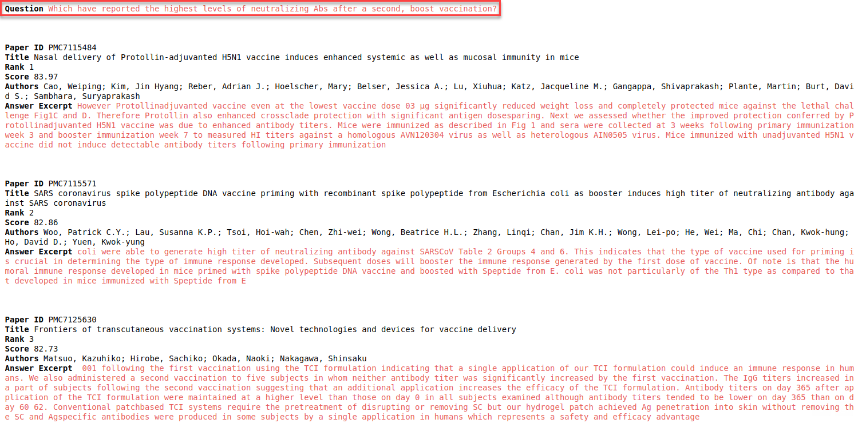
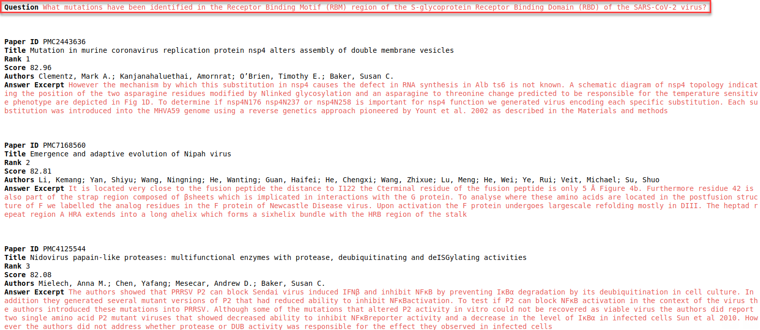
Search State-Of-The-Art
Implemented using deep bidirectional transformers for language understanding. Results ranked by score, with the question directly answered with the most relevant excerpt from the paper (highlighted red).
Unfortunately model training limited to only 5K articles due to local lab system GPU VRAM constraints. Better results expected with larger training set.
Multiple trials per paper is accounted for
Tested with 3 transformer models pre-trained on biomedical datasets.

Slide 9
Summary
Main research cockpit concept is viable. Main features realised as working prototypes. Value of NLP processing complex, biomedical specific problem domain, free text dataset is demonstrated.
Clarity on NLP pipeline requirements via prototyping at granular level with Jupyter notebooks, will help Azure industrialisation.
Better understanding of compute resource requirements. For example, through prototyping main features of each NLP pipeline stage, steps which are more CPU bound (e.g. data cleansing) or GPU bound (e.g. transformer model training) have been identified. This supports infrastructure design of the pipeline & more appropriate/cost effective allocation of compute resources.
How to unambiguate authors? How do you separate one author John Doe from another author John Doe, so that each can be uniquely identified and associated with the correct citations and co-author network?
Main challenge has been demands on local lab compute resources. Data cleansing steps time to complete limited by CPU clock speed and IPC (instructions per cycle). Dataset size to be encoded by transformer models for search limited by available GPU VRAM. Justifies migration to cloud (and possibly upgrade of lab resources).
Next Steps Confident that prototyping has proven the main required features viable, next step is to design the required Azure infrastructure and migrate prototyping for a cloud-hosted minimum viable product with user interface.

